Slide 1

Advanced Parking System Using IoT
by
Revanth D
Roll No. 204G1A3336
Mahitha K
Roll No. 204G1A3320
Mamatha C
Roll No. 204G1A3321
Sai Hemanth Kumar M
Roll No. 204G1A3339
Under the guidance of
Mr. A. Kiran Kumar , M.Tech(Ph.D)
Assistant Professor
Department of Computer Science and Engineering (AI&ML)
Srinivasa Ramanujan Institute of Technology
Autonomous
Rotarypuram Village, B K Samudram Mandal, Ananthapuramu – 515701.
2023-2024

Slide 2
Contents
Abstract
Introduction
Literature survey
Existing System
Proposed system
Planning and Design
Implementation
Output
Paper submitted proof
References

Slide 3
Contents
Components & Description
Work Flow Implementation for first objective
Work Flow Implementation for Second objective
GitHub Project Dashboard
Queries

Slide 4
Abstract
The increasing metropolitan cities and growing number of Vehicles have led to significant challenges in managing parking spaces effectively and ensuring the security of parked vehicles. To address these issues we propose comprehensive prototype of an Advanced parking system that utilizes IoT model and framework. Using an IoT application it enables to verify the availability of slots over the area.
The prototype incorporates advanced sensors to detected improperly parked vehicles, parallelly triggering an alarm system to alert the relevant personnel. This solution aims to provide a seamless parking experience for users while optimizing parking space utilization and enhance overall security measures.

Slide 5
Problem Statement
Scarcity of parking spaces in cities is causing significant challenges for vehicle owners, leading to increased congestion and frustration.
There is a need for a solution leveraging the IoT setup & integrated platform to address this issue by providing real-time parking slot availability and allowing users to book their required slots in advance.
Additionally, incorporating a sensor mechanism is crucial to identify and address instances of improper parking, contributing to better traffic flow and safety.

Slide 6
Objectives of Project
Research Objective 1: To develop an IoT-based system that can accurately and efficiently detect parking slot availability in a defined parking area, providing real-time information to users and developing the Automated Gate System.
Research Objective 2: Extension to above setup to develop a effective parking management system using sensor mechanism to detect and address the improper parking instances and to implement Slot Booking System using an software platform.

Slide 7
Proposed System
Smart Parking Solution:
- Implementing appropriate sensors to check the parking slots availability
- Utilizing an IoT based platform for real-time parking slots availability information.
- Enabling an advance slot booking system to streamline the implemented parking process.
Sensor Mechanism for Traffic Management:
- Integrating sensors to identify improper parking instances.
- Notify authorities for prompt action for those instances using buzzer.

Slide 8
Literature survey on paper-4
Methodology
The methodology of the IoT-Based Advanced Parking System involves a multifaceted approach to urban parking management. It begins with the strategic deployment of sensors, utilizing cutting-edge technologies like ultrasonic or infrared, to detect real-time parking slot availability and identify improper parking instances. The data collected by these sensors is transmitted wirelessly to a central IoT platform, which acts as the intelligence hub for processing and analysis. The integration of a Gate System ensures secure entry and exit regulation based on real -time parking conditions. User interaction is facilitated through Blynk applications, allowing for seamless access to real-time parking information and the convenience of reserving parking slots in advance.

Slide 9
Cont.…
Literature survey on paper-4
Sensor Mechanism play a crucial role in detecting improper parking, triggering immediate real - time alerts for swift intervention. Violations such as occupying multiple slots, parking in restricted zones, or exceeding time limits trigger immediate alerts. Security personnel or administrators receive real-time notifications as a buzzer alert to address improper parking instances promptly. Continuous monitoring is implemented to ensure the optimal performance of both hardware and software components. Evaluation metrics, such as traffic congestion reduction, user satisfaction, and parking information accuracy, provide a basis for ongoing improvements and updates to enhance the system's effectiveness over time. The overall methodology underscores a comprehensive and technology-driven approach to address the complexities of urban parking challenges

Slide 10
Expected Outcomes
Literature survey on paper-4
The following are considered as the expected outcomes of the proposed project:
Real-time detection of parking slot availability with in the defined parking field.
Implementation of Smart Gate System improves overall security & effectiveness of the setup at entry and exit levels.
Developing an Accurate Improper parking instance detection with integrated alert system and a User-friendly Slot Booking System interface.

Slide 11
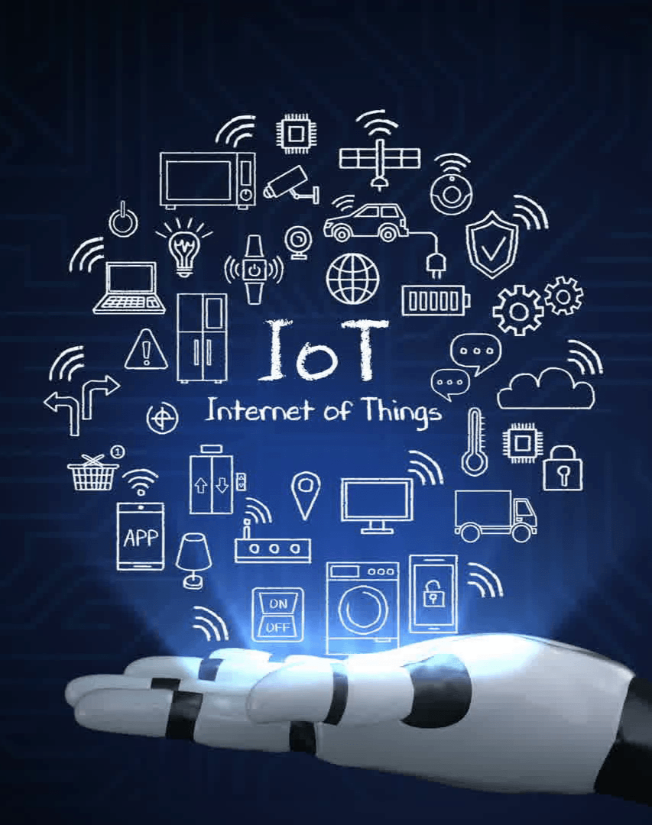
Project’s Field of Application
Literature survey on paper-4
IoT stands for the "Internet of Things." It refers to the network of physical objects, devices, vehicles, and other items embedded with sensors, software, and connectivity, which enables them to connect and exchange data.
This network allows these objects to collect and exchange data, leading to the creation of smart, interconnected systems and environments.
IoT technology is utilized for a wide range of applications, including smart home devices, industrial automation, environmental monitoring, healthcare systems, and much more.

Slide 12
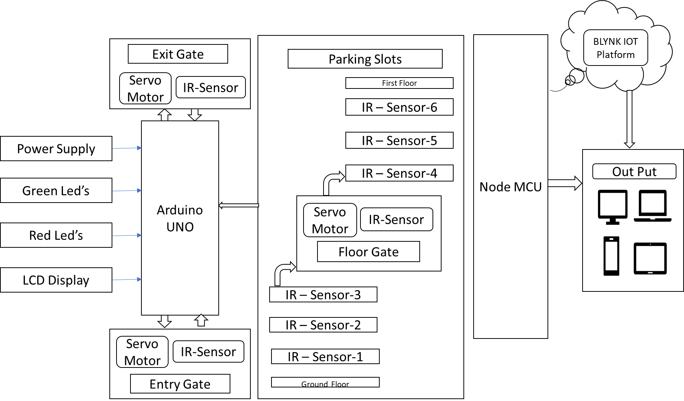
Basic Block Diagram
Literature survey on paper-4

Slide 13
Design & Implementation of Objective-1
Components & Description
Hardware Components:
Arduino Mega
Node MCU
IR sensors
Servo motors
LCD display
Buzzer
Transformers, Regulators, Capacitors
Power supply 12v AC
12v 1A Adapter
LED indicators (Green & Red)
Jumper wires
Software Components:
Blynk IoT platform
Arduino IDE software
TinkerCAD Web based Software

Slide 14
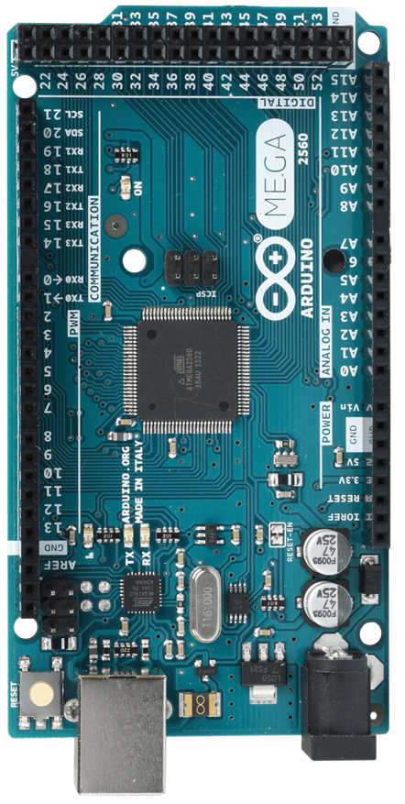
Arduino Mega2560 R3-Board
The Arduino Mega 2560 R3 is a microcontroller board based on the ATmega2560. It is an updated version of the original Arduino Mega.
The Arduino Mega 2560 R3 offers a generous 54 digital input/output pins, 16 analog inputs.
With 256 KB of flash memory and 8KB of SRAM, the Mega 2560 offers significantly more storage space than the standard Arduino Uno.
The Mega 2560 is compatible with most shields designed for the Arduino Uno and other boards, making it easy to expand its capabilities with additional modules and sensors

Slide 15
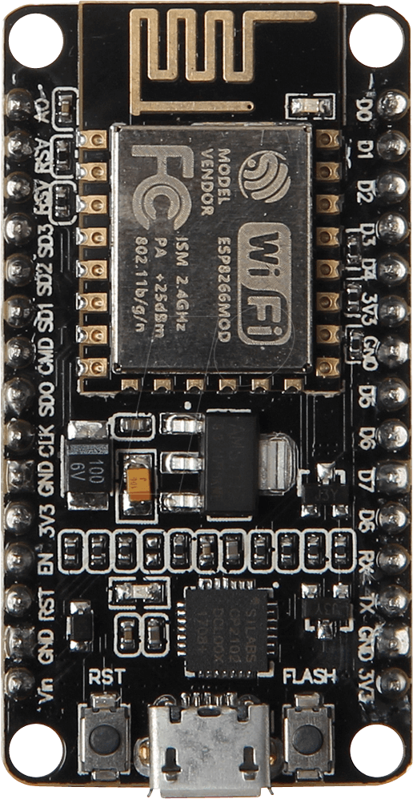
Node MCU
Node MCU
Node MCU can transmit data wirelessly to a central server or cloud platform, allowing parking operators or users to access parking space availability information via a smartphone app or a website.
The Node MCU development board typically features several GPIO (General Purpose Input/Output) pins, which may include GPIO0, GPIO1, GPIO2, GPIO3, GPIO4, GPIO5, GPIO9, GPIO10, and others, depending on the specific Node MCU board version.
Node MCU's Wi-Fi capabilities and compatibility with various sensors and actuators make it a versatile choice for enhancing the functionality of a car parking system

Slide 16
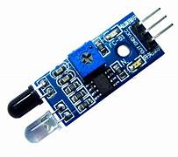
Arduino UNO
IR Sensors Module
IR (Infrared) sensors are electronic devices that can detect and respond to the presence of infrared radiation.
Infrared radiation is a type of electromagnetic radiation that is invisible to the human eye because it has a longer wavelength than visible light.

Slide 17
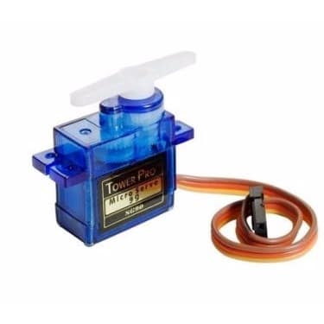
Arduino UNO
Servo Motor
Servo motors are a type of rotary actuator that provides precise control of angular or rotational position, velocity, and acceleration. They are widely used in various applications that require controlled and automated movement.

Slide 18
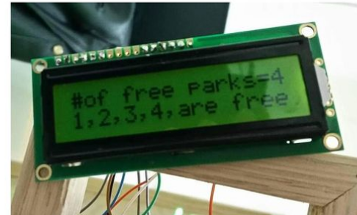
Arduino UNO
LCD’s (Liquid Crystal Display)
LCD stands for "Liquid Crystal Display." It is a type of flat-panel display technology used in a wide range of electronic devices, from televisions and computer monitors. LCDs are preferred for their thin and energy-efficient characteristics.

Slide 19
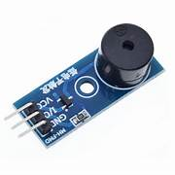
Arduino UNO
Buzzer Module
A buzzer in the context of IoT refers to a type of audible indicator that can be integrated into Internet of Things (IoT) devices or systems.
It is typically used to produce sound alerts, notifications, or indications based on specific conditions or triggers within the IoT environment. This can include alerting users to events such as motion detection, system malfunctions, or successful operations..

Slide 20
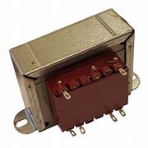
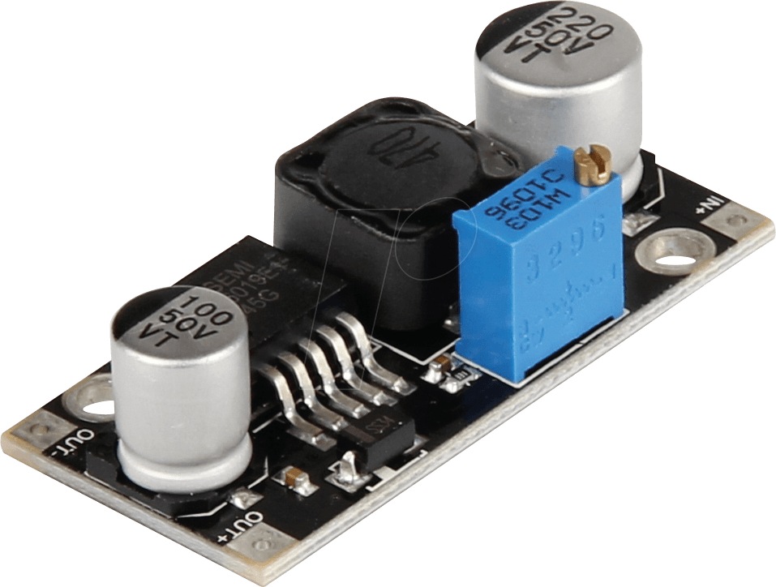
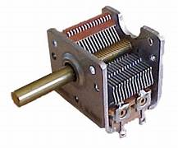
Transformers, Regulators & Capacitors
Transformers are electrical devices that are used to transfer electrical energy between circuits through electromagnetic induction. In IoT, they are used for voltage transformation, isolation, and impedance matching.
Regulators are electronic components or circuits used to maintain a constant output voltage or current level. They are essential for stabilizing power supply voltages, which is critical for the reliable operation of IoT devices.
Capacitors are passive electronic components that store and release electrical energy. In IoT, capacitors are used for power conditioning, energy storage, noise filtering, and maintaining stability in voltage levels.

Slide 21
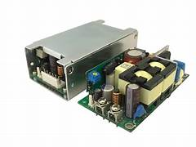
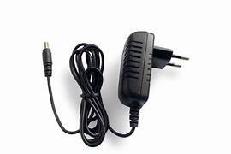
LED Indicators & Jumper Wires
12V AC Power Supply is an electrical power supply that provides power at a voltage level of 12 volts in the form of an alternating current (AC). AC power is the standard form of electrical power distributed to homes and businesses.
12V 1A Adapter is a power adapter that converts AC power from a wall socket to a lower voltage level (12V) and direct current (DC). The 1A specification indicates the current rating of the adapter, which in this case is 1 ampere.

Slide 22


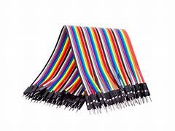
LED Indicators & Jumper Wires
LEDs (Light Emitting Diodes) are used to visually indicate the status of a device or to provide feedback to the user. They are often used in IoT projects to showcase the activation of a sensor, the connection status of a device, or the output of a microcontroller.
Jumper wires are used to create electrical connections between different components such as sensors, microcontrollers, and other electronic modules. They are crucial for establishing the necessary circuitry in IoT projects.

Slide 23
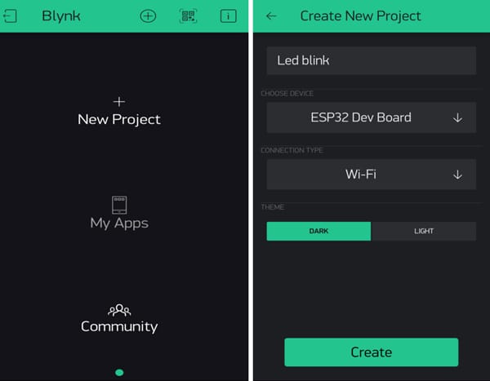
Arduino UNO
Blynk IoT Application
Blynk is a popular Internet of Things (IoT) platform that simplifies the development of IoT applications and allows users to create custom mobile apps for controlling and monitoring IoT devices.
Blynk IoT is focused on remote monitoring and management of IoT devices through a cloud based interface.

Slide 24
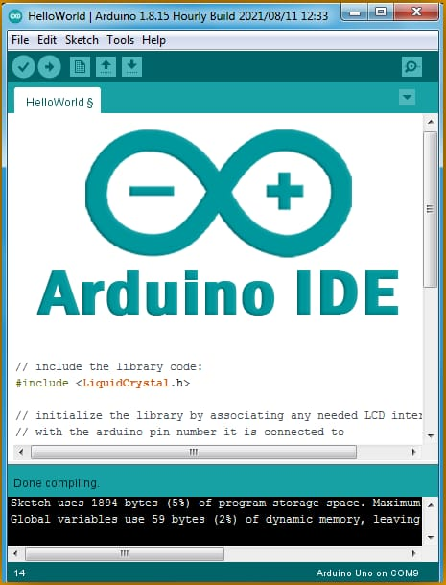
Arduino UNO
Arduino IDE
Arduino IDE is a software development environment (IDE) used to create and upload sketches (Programs) to Arduino board. It provides a graphical user interface (GUI) to write and edit the code and visualizes the board’s output.
It includes a built-in compiler and supports various programming languages such as C, C++, Java, Python, Rust etc.

Slide 25

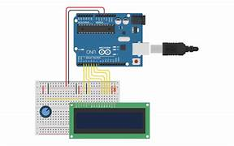
TinkerCAD Software
A Tinker-CAD is a web-based computer-aided design (CAD) software that allows users to create 3D models and electronic circuit designs. It provides a user-friendly interface for creating and simulating electronic circuits
Tinker-CAD can be used to design and simulate electronic circuits that are commonly found in IoT devices.
Users can visually lay out the components of their IoT device and simulate its behavior before actually building the physical prototype. This can help in testing and refining the electronic design before moving to the physical implementation stage, saving time and resources.

Slide 26
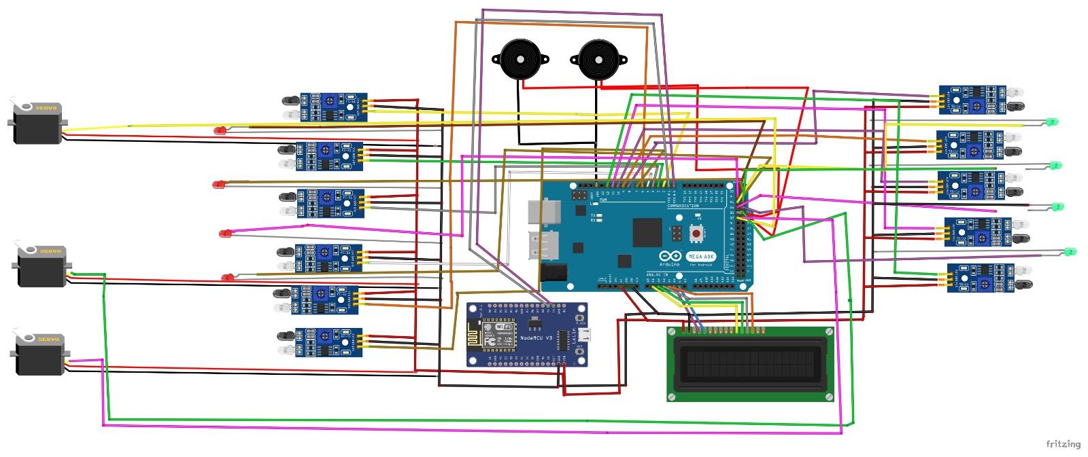
Complete Circuit Arrangement of the project

Slide 27
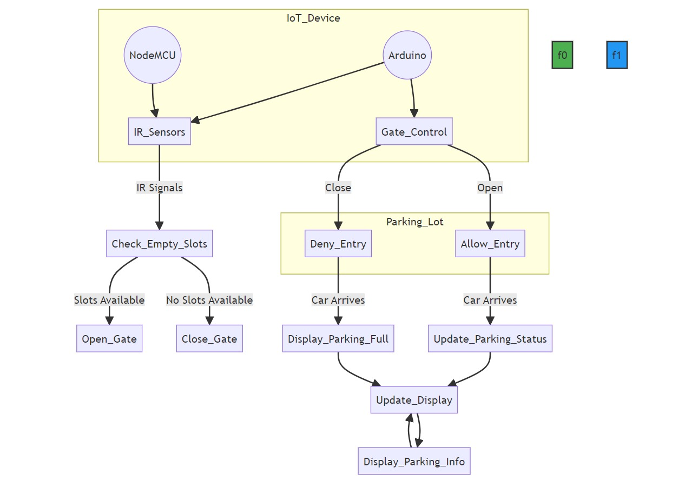
Arduino UNO
Design and Implementation for first objective

Slide 28
Explanation for first objective
The first part of the Objective 1, involves strategically deploying cutting-edge sensors, such as ultrasonic or infrared, in the defined parking area. These sensors are crucial for accurately detecting real-time parking slot availability. The collected data from the sensors is then transmitted wirelessly to a central IoT platform, which serves as the intelligence hub for processing and analysis. This integrated approach ensures that users have access to up-to date information about parking availability. Additionally, the deployment includes the integration of an Automated Gate System to regulate secure entry and exit based on the real time parking conditions.

Slide 29
Cont..
In the second part of Objective 1, user interaction is facilitated through Blynk applications. This allows users to seamlessly access real-time parking information and conveniently reserve parking slots in advance. The Blynk applications enhance the user experience and contribute to the overall efficiency of the IoT-based parking system. This part of the objective emphasizes the user-centric design aspect of the system, ensuring that the technology not only accurately detects parking availability but also provides a user-friendly interface for interaction and convenience.

Slide 30
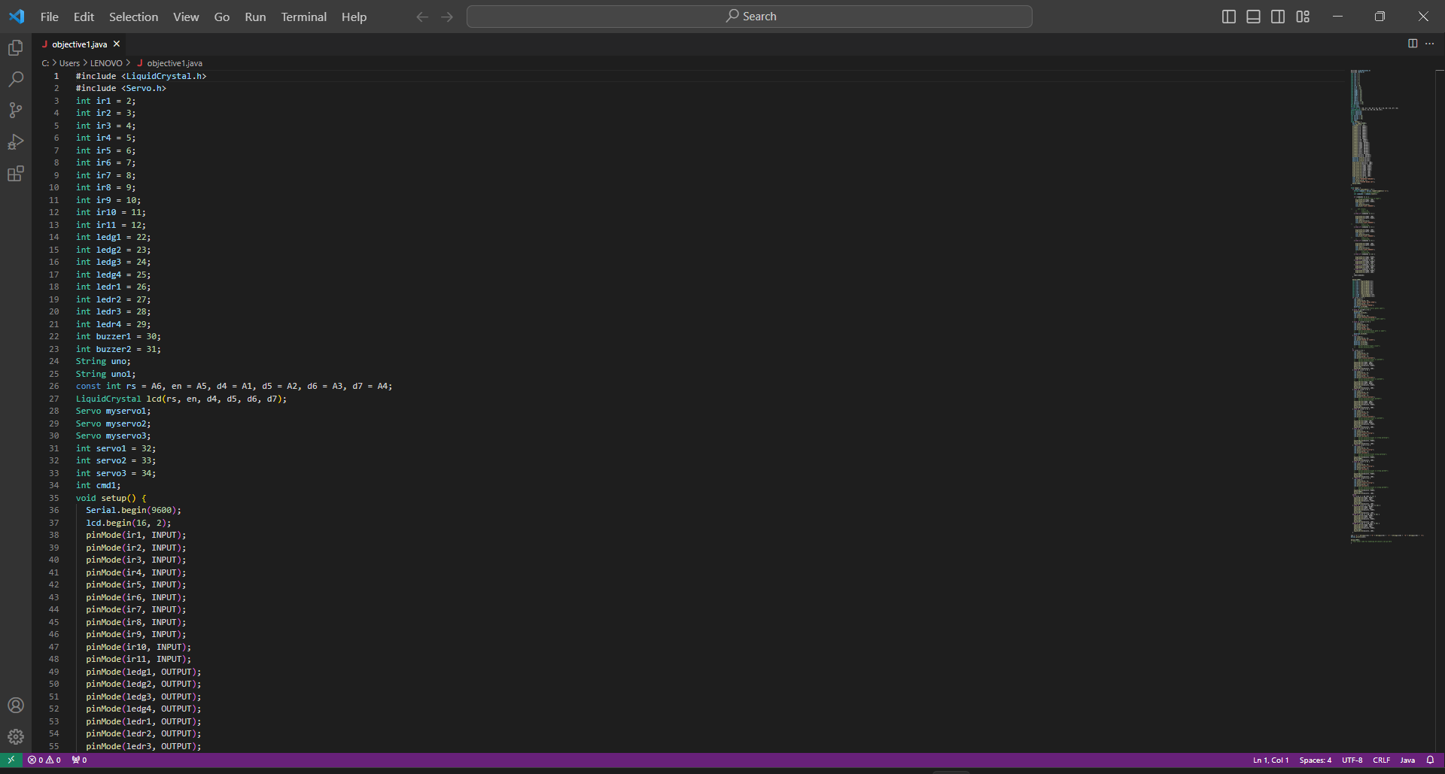
Code Implementation for First objective

Slide 31
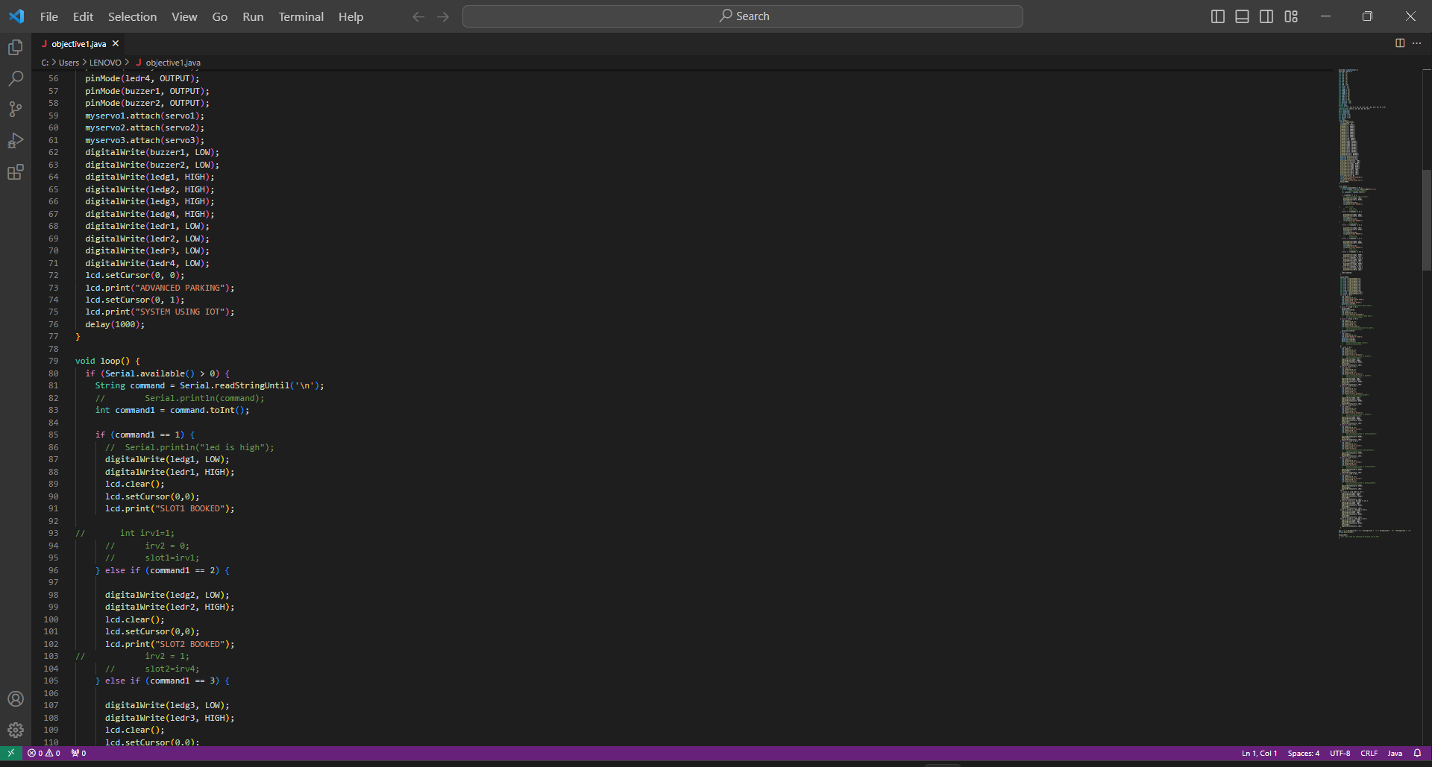
Code Implementation for First objective

Slide 32
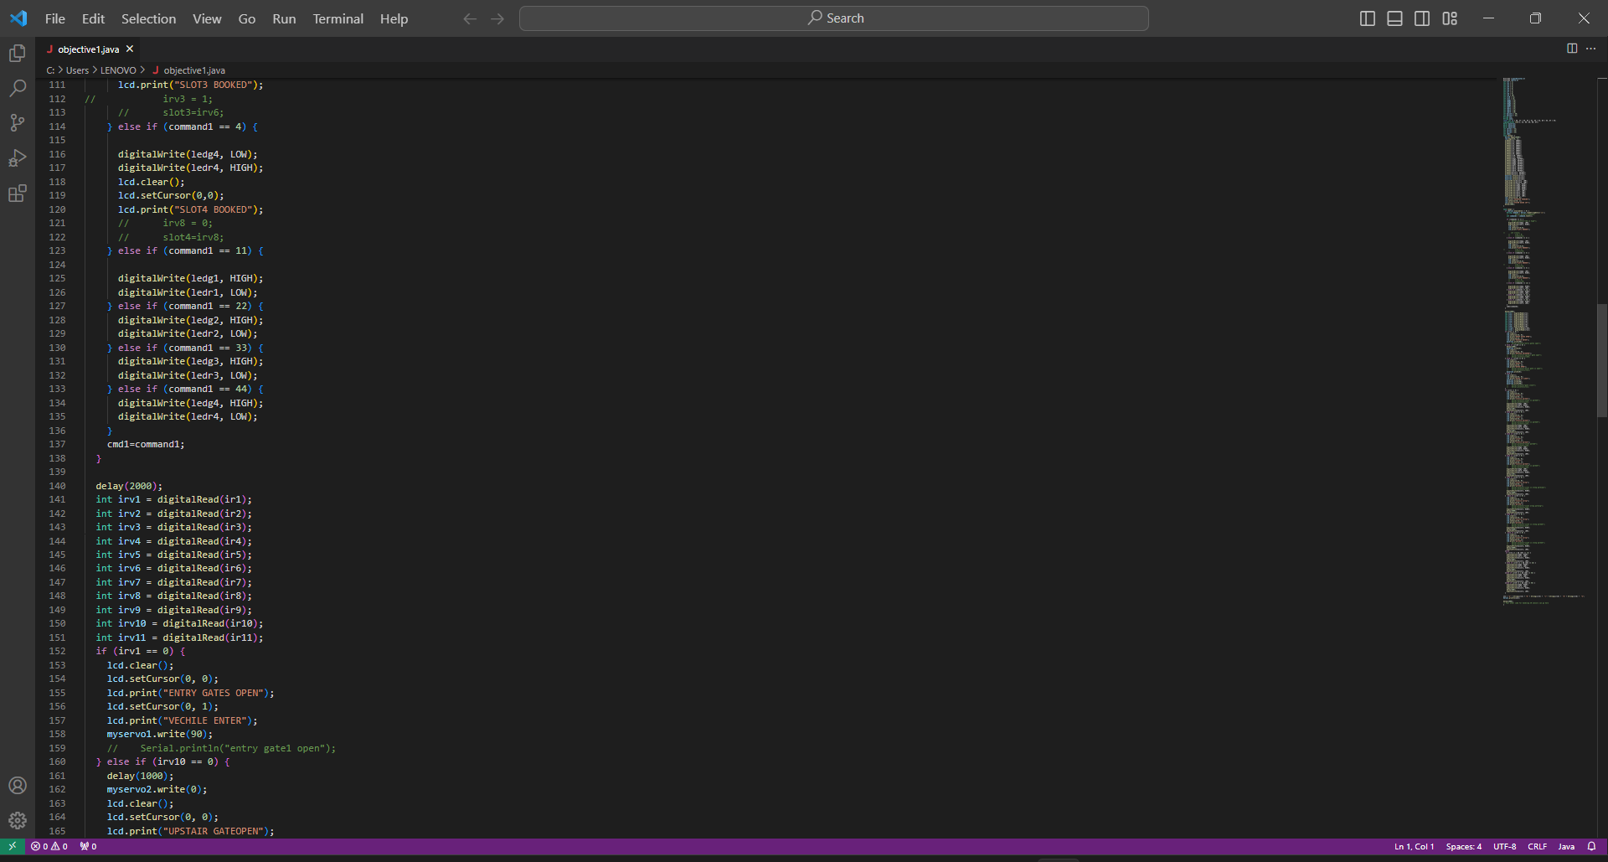
Code Implementation for First objective

Slide 33
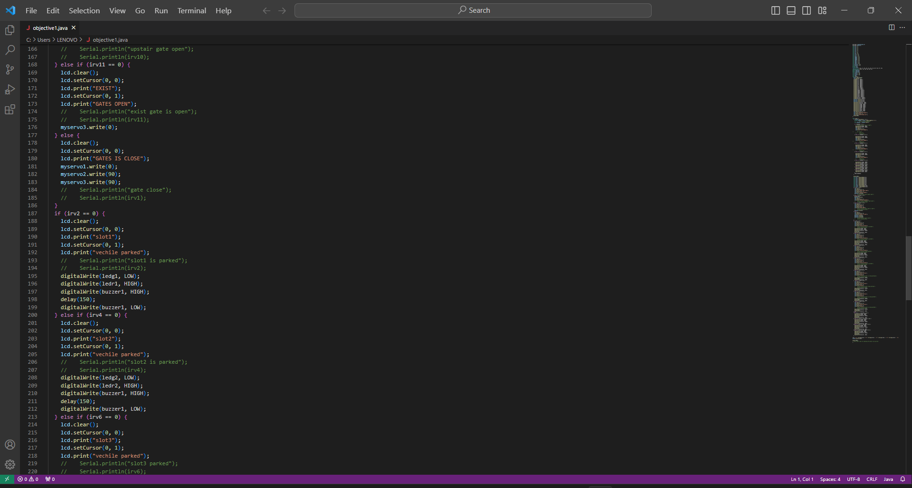
Code Implementation for First objective

Slide 34
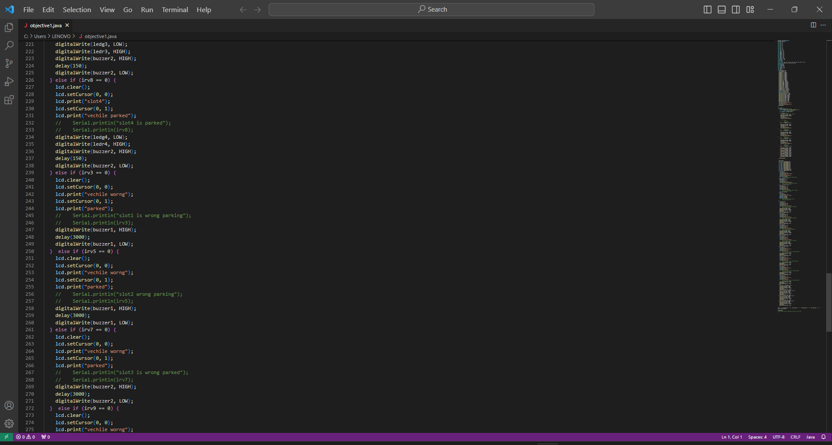
Code Implementation for First objective

Slide 35
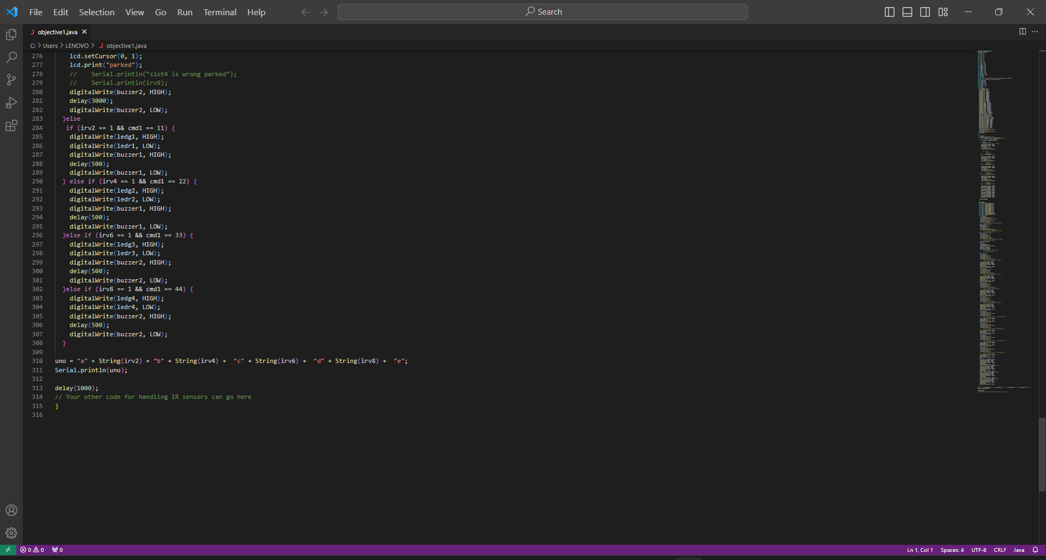
Code Implementation for First objective

Slide 36
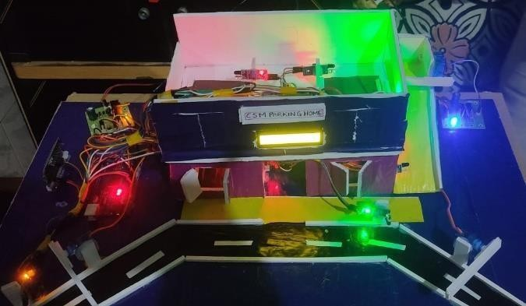
Proto type Architecture
Final Hardware Prototype of Proposed System

Slide 37
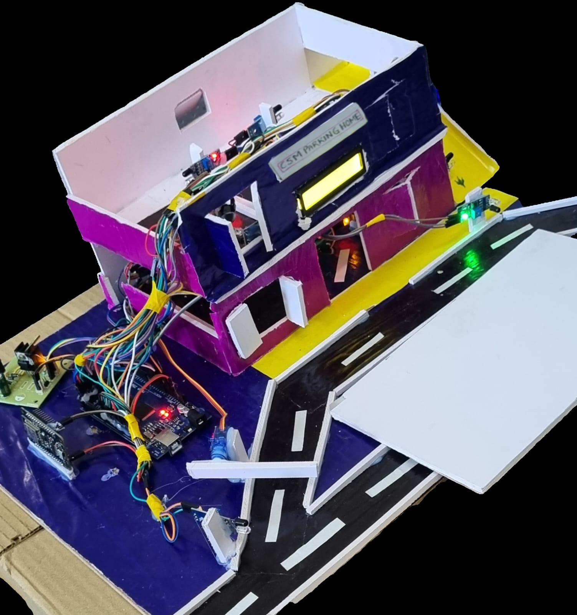
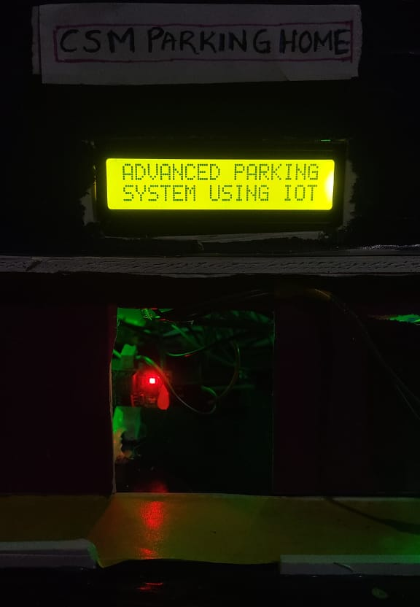
Proto type Architecture
Final Hardware Prototype of Proposed System

Slide 38
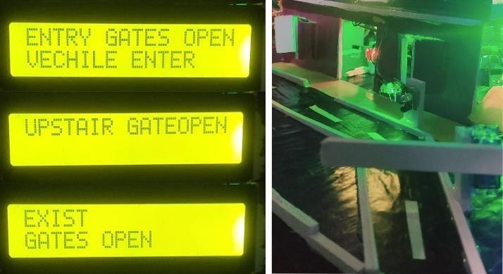
Results for First objective
Gate System Mechanism for Prototype

Slide 39
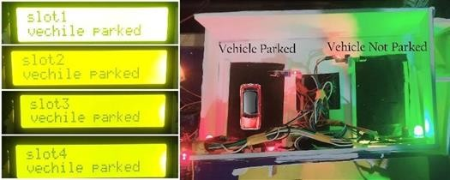
Results for First objective
Availability Of Parking Slot Checking

Slide 40
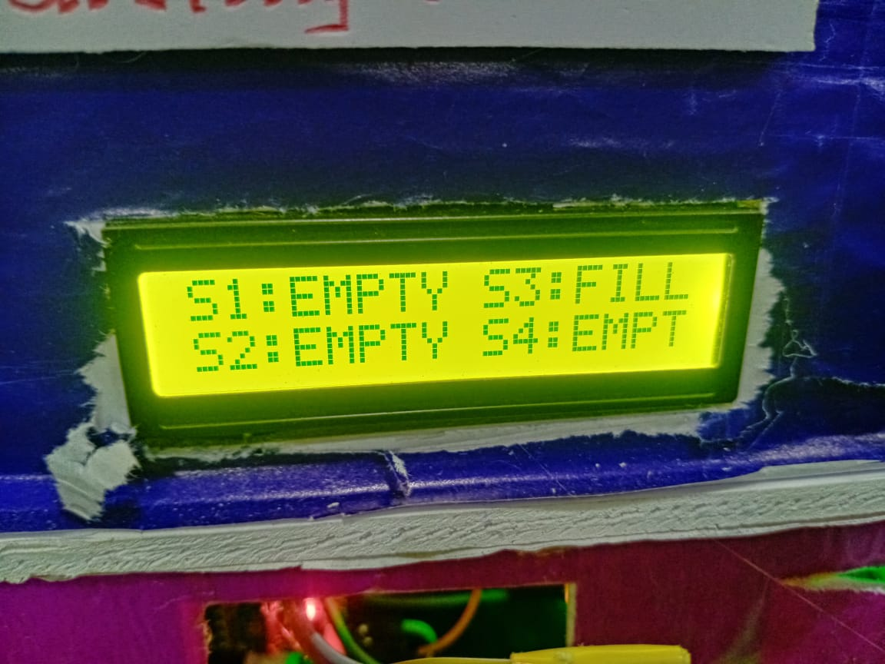
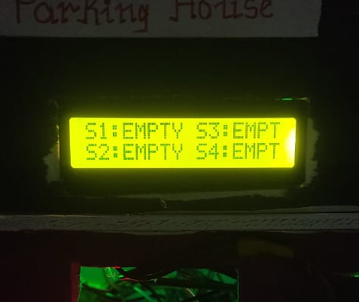
Results for First objective
Availability Of Parking Slot Checking

Slide 41
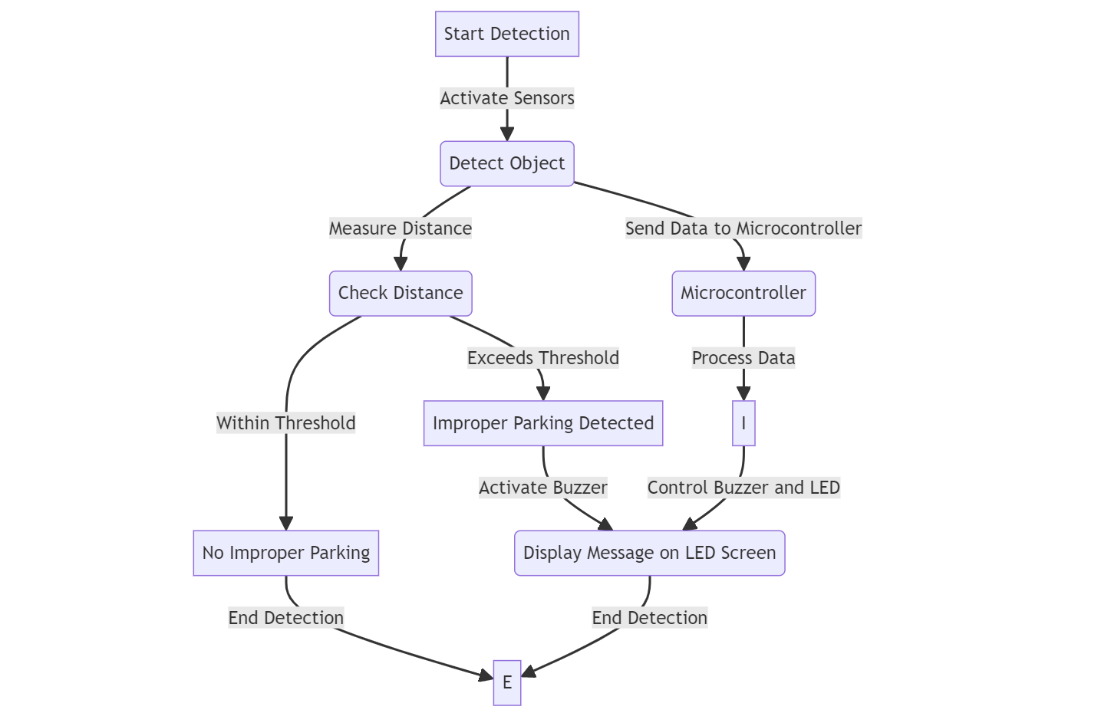
Design and Implementation for Second objective
Arduino UNO

Slide 42
Explanation for Second objective
The initial focus of the objective 2, is the implementation of a sensor mechanism to detect and address improper parking instances. This component is critical for maintaining order in the parking area and triggering immediate real-time alerts for swift intervention. The sensor mechanism, in conjunction with the overall IoT system, plays a key role in enhancing the security and efficiency of the parking management system.
In the second part of Objective 2, the emphasis shifts to the practical implementation of the system's capabilities. Violations such as occupying multiple slots, parking in restricted zones, or exceeding time limits lead to immediate alerts. These real-time notifications, including buzzer alerts, are transmitted to security personnel or administrators. This part underscores the system's ability to actively address and rectify improper parking behavior promptly, contributing to the overall effectiveness of the IoT-based parking management system.

Slide 43
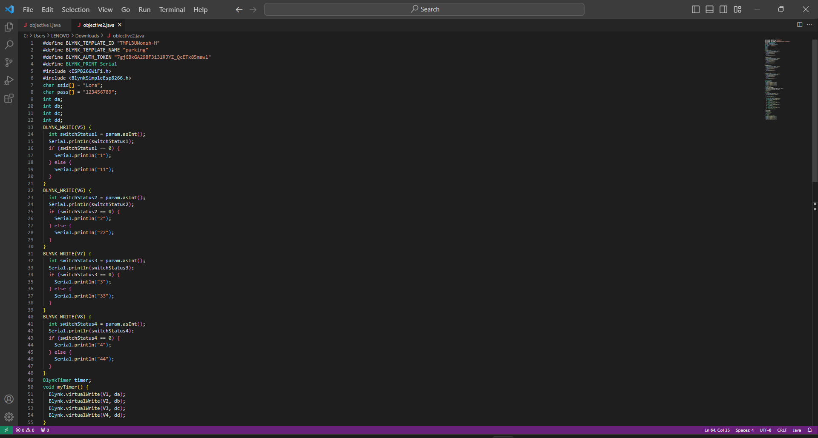
Code Implementation for Second objective

Slide 44
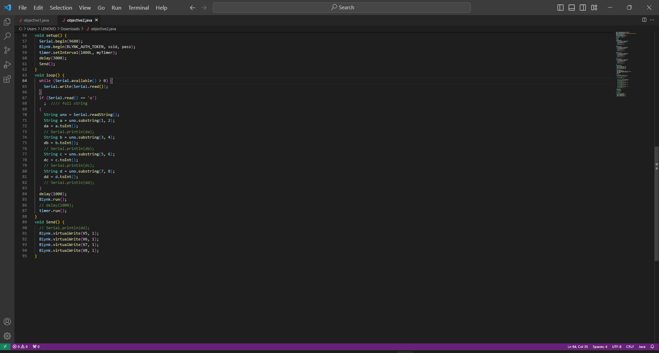
Code Implementation for Second objective

Slide 45
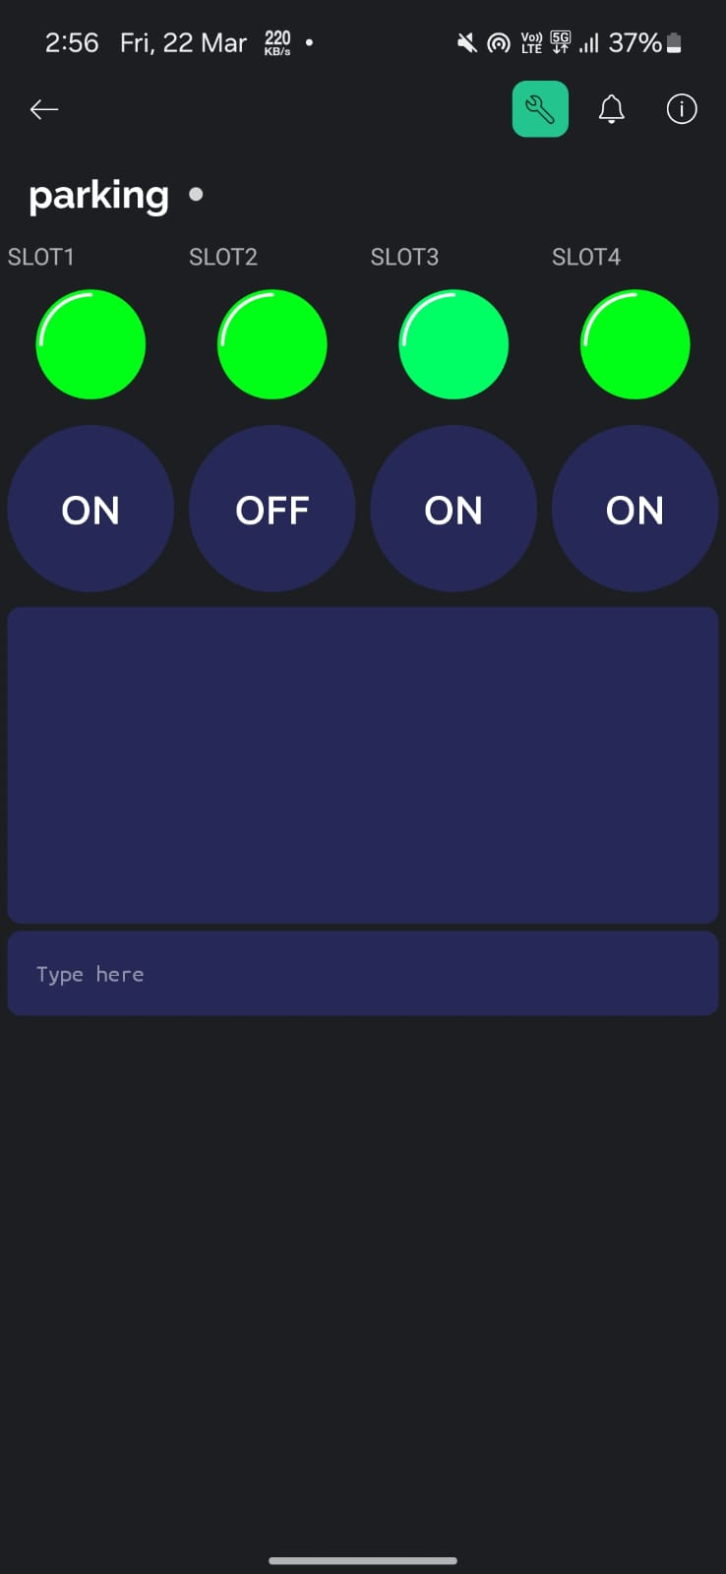
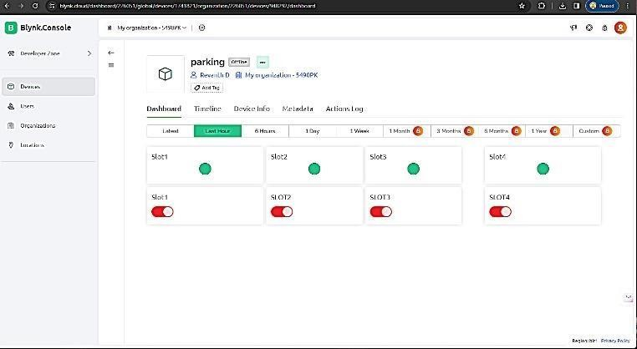
Results for Second objective
Desktop View
Slot Booking System using Blynk IoT Application
Mobile View

Slide 46
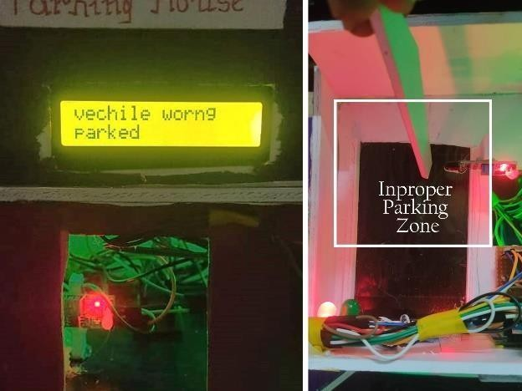
Results for Second objective
Improper Parking Instances and Alert Mechanisms

Slide 47
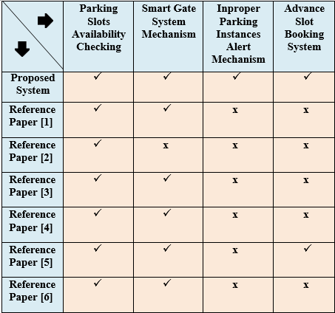
Differences between Proposed System and Existing Systems

Slide 48
References
[1] K. Shirisha1, Gurram Chandana, Kadipikonda Akhila, Lukalapu Koteshwari, Ramidi Sucharitha, “SMART VEHICLE PARKING SYSTEM”,Journal of Engineering Sciences jespublication.com, vol. 13, pp. 924-931, Dec 2022.
[2].Amara Adityaa , Shahina Anwarula, Rohit Tanwara, Sri Krishna Vamsi,Konerua, “An IoT assisted Intelligent Parking System (IPS) for Smart Cities” ,Peer-review under responsibility of the scientific committee of the International Conference on Machine Learning and Data Engineering,
(https://creativecommons.org/licenses/by-nc-nd/4.0) ,pp. 1045-1054, 2023.

Slide 49
References
[3].Harpreet Singh Bedi*, K V Krishnam Raju, M Venkata Sriram, Hiroshima Khoisnam, Kesavarapu Jahnavi, P Naga Sai SEEE, “Design and implementation of IoT Based Smart Parking System using NodeMCU ESP8266” International Journal of Mechanical Engineering, vol. 7 ,pp.1-6, (Special Issue 5, April 2022).
[4].Vishwajeet Haralkar, Tushar Kanthale, Harsh Poddar, “REAL TIME CAR PARKING SYSTEM”,International Journal of Creative Research Thoughts (IJCRT) www.ijcrt.org, vol. 11, pp. 1-6, 5 May 2023.

Slide 50
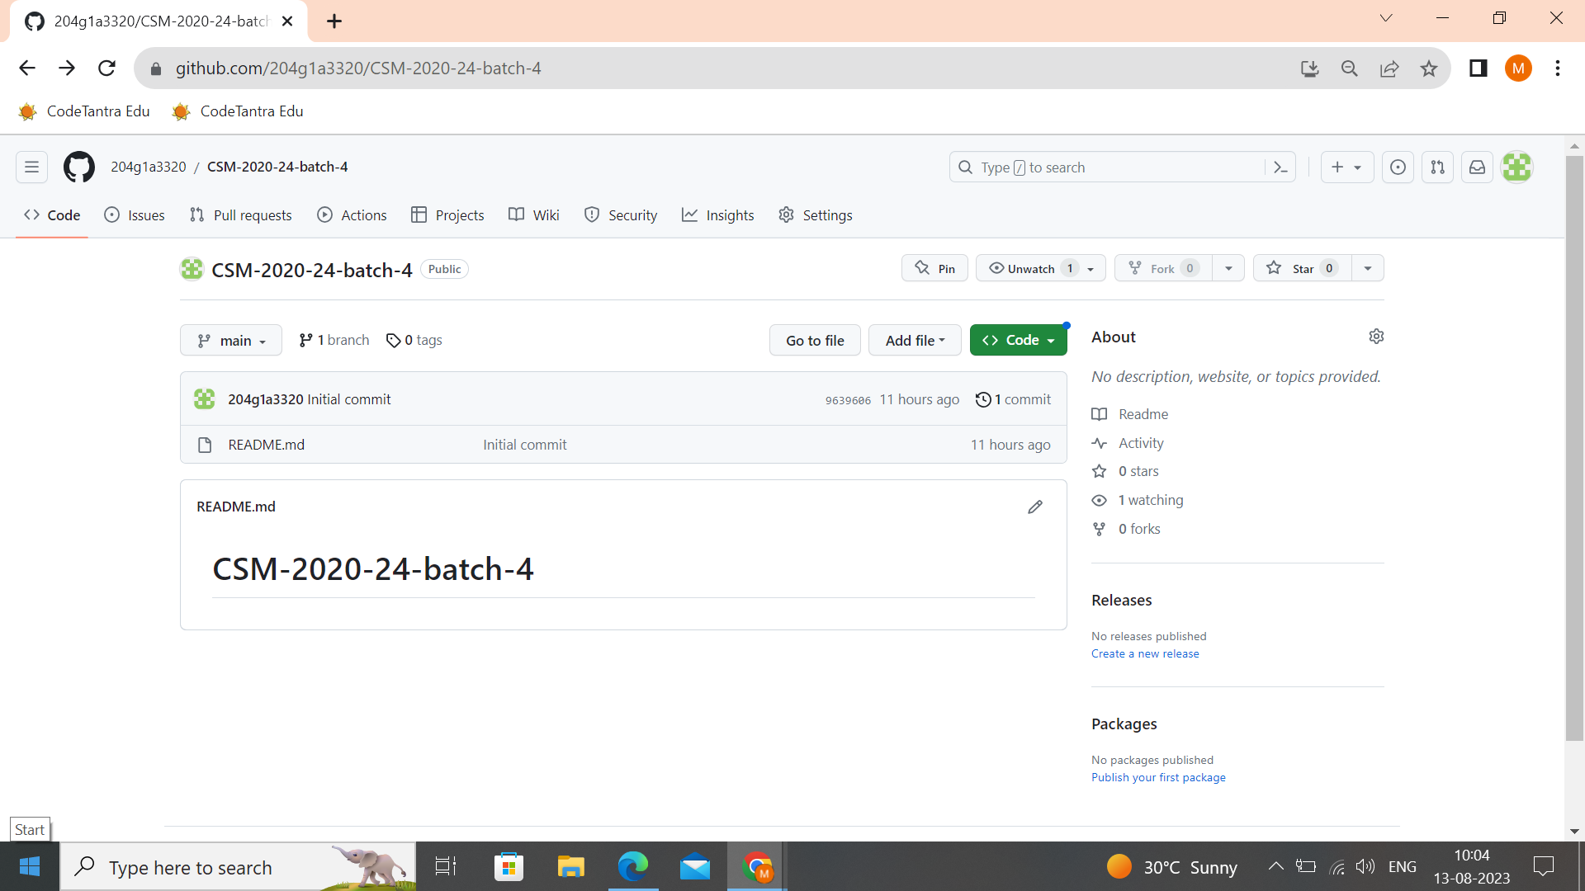
Git Hub Project Dashboard

Slide 51
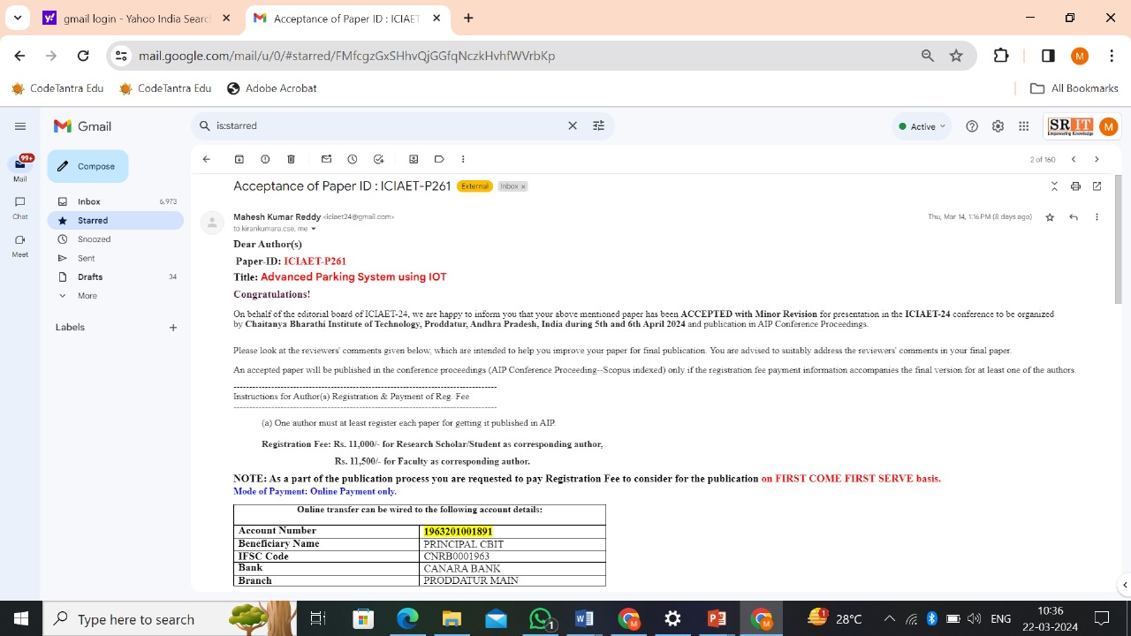
Paper Submitted Proof

Slide 52
Any Queries?

